Slide 1
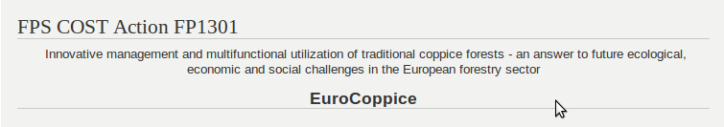
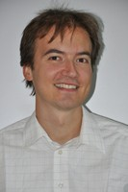
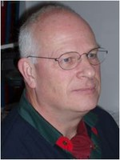
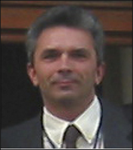
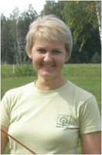
DEFINITIONS AND TYPOLOGY
Work group 1
2014 November
Ivailo
/Ивайло Markoff /Марков

Slide 2






























We must look to find similar and to harmonize definition of COPPICE forest!
We should to find different for typology off copice forests!

Slide 3
Why?
This COST Action aims to bring together European scientists, experts and young scholars to exchange knowledge about coppice forestry and to start developing innovative management and utilization concepts/techniques for future modern multifunctional coppice management systems.

Slide 4
WP1: Definitions and Typology
WP1:
collect coppice forests related definitions based on literature review and contacts with stakeholders experienced in practical coppice forests management;
technical terms and their definitions vary substantially between areas and countries;
existing types of coppice forests (based e.g. on species, terrain, ecosystem, management type) are collected, described and classified;
available statistical data about coppice forests;
identify knowledge gaps or shortcomings e. g. related to national forest inventories;
identify scientists, professional specialists, working groups, institutions or experts which have scientific or practical experience and traditional knowledge on coppice forest management;
derive actual knowledge which may not be documented and published in official papers or journals.

Slide 5
Milestones
Milestone 2: Database of terminology (WG 1). First year.
Milestone 3: Coppice forest typology factsheet (WG 1). Second year.
WG 1 will be in charge of specifying definitions, collecting statistical data in all participating countries and listing coppice scientists and experts. Furthermore, WG1 will be responsible to the glossary which will be published in Year 3.

Slide 6
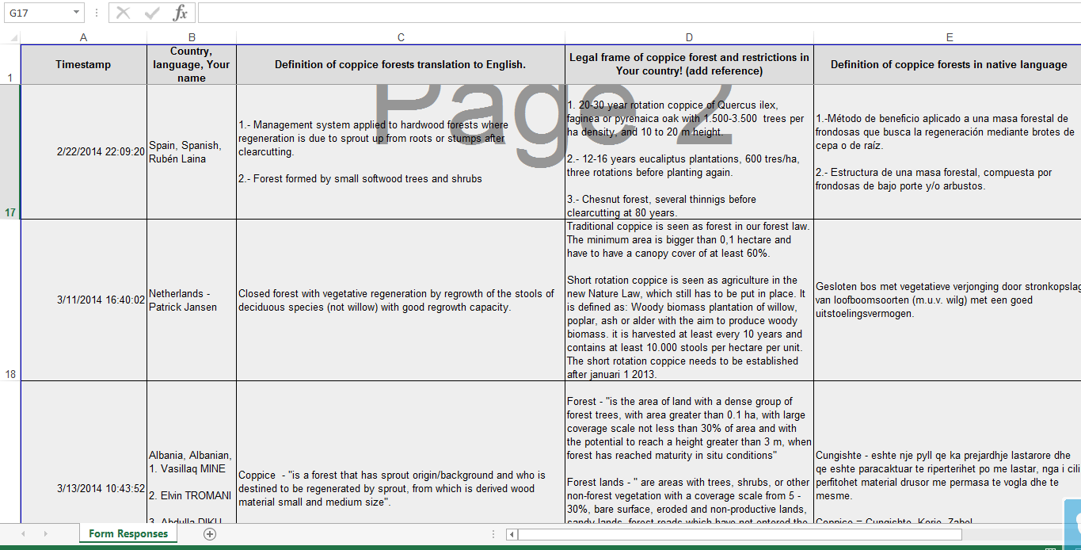
Work plan and cooperation with an other groups:
Collecting, comparing and synthesizing the various expressions and definitions which are related to CFM. This will be then developed further to a glossary and will be continuously improved and enlarged during the life time of the project.
  Results of questionaire about legal frame definitions will be send to participants to update them and to add info about statistical data.(if there are several different in federal states, please add info about all of them)

Slide 7
Work plan and cooperation with an other groups:
2. Collecting, cross checking and compiling statistical and other data on coppice forests available in the participating countries and regions. This will be a “living document” being continuously improved during the live time of the project. A final fact sheet about European Coppice Forests will be ready at year 3.
  An other questionaire to put in statistics related to exsisting coppice forests typology in eache country.
  Including other coppice types, for exsample SRC, but no focusing of them in details – our main subject are forest lands.

Slide 8
Work plan and cooperation with an other groups:
3. Setting up a list of coppice scientists and experts, this will be posted in year 1 at the first time and then continuously updated until the end of the project.
  Enda Coates should to finish his task as soon it is possible. List will be used for questionaires and consultations and sharing of information
  We will ask to experts to produce list of no more than ten publications related to copice forestry for country - to undestand which topics are more covered in each country and where is knowlege gaps.

Slide 9
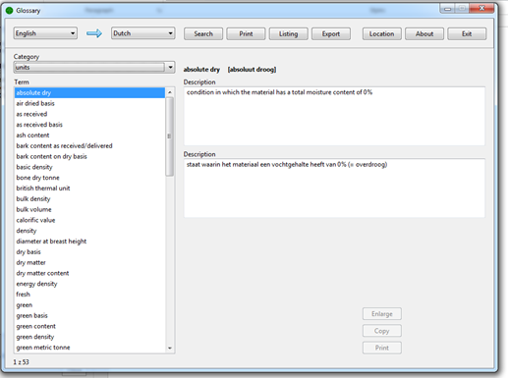
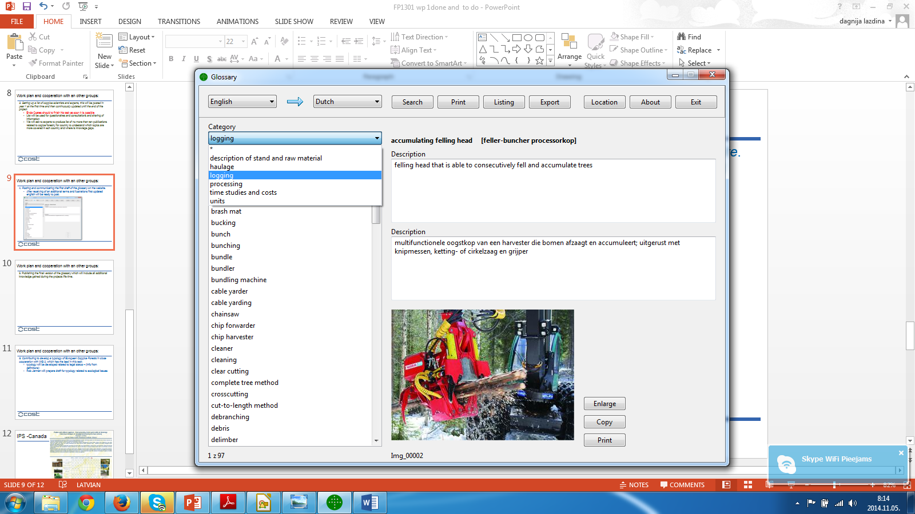
Work plan and cooperation with an other groups:
4. Posting and communicating the first draft of the glossary on the website.
  After receiving of an additional terms and ilustrations first updated english-german will be ready to post.
We asking to an other WG leaders to organize producing list of terms related coppice and explanation (English only) and illustration (picture or photo). During next week at least 10, because Carolina are going to they STSM to work on it.

Slide 10
Work plan and cooperation with an other groups:
5. Publishing the final version of the glossary which will include all additional knowledge gained during the projects life time.
  2015

Slide 11
Work plan and cooperation with an other groups:
6. Contributing to develop a typology of European Coppice Forests in close cooperation with WG 2, which has the lead in this task.
  At first typology will be developed ralated to legal status – (info from definitions)
  Rob Jarman will prepare draft for typology related to ecological issues

Slide 12
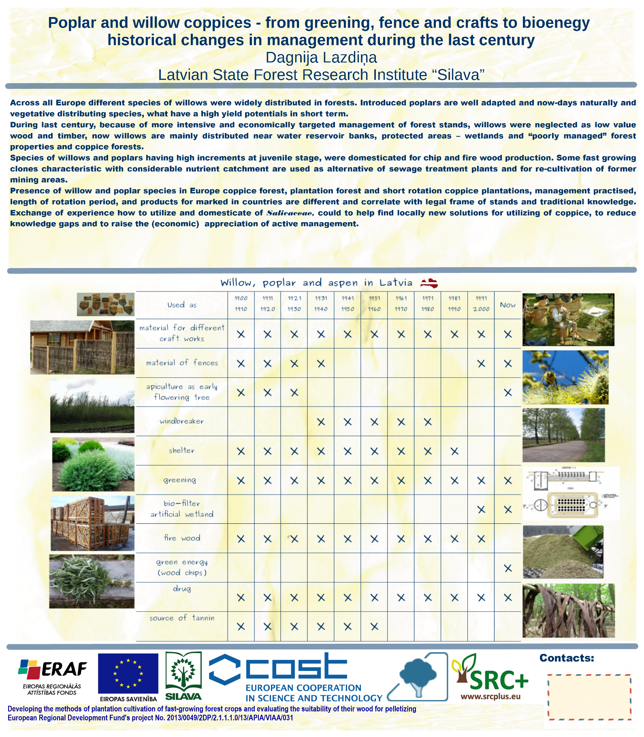
IPS -Canada

